Slide 1
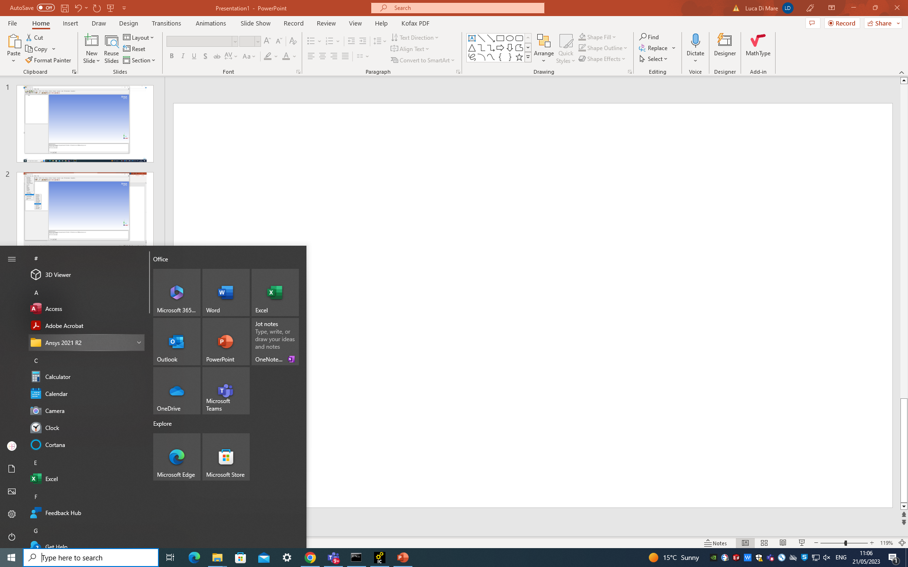
Select Ansys from your windows start menu

Slide 2
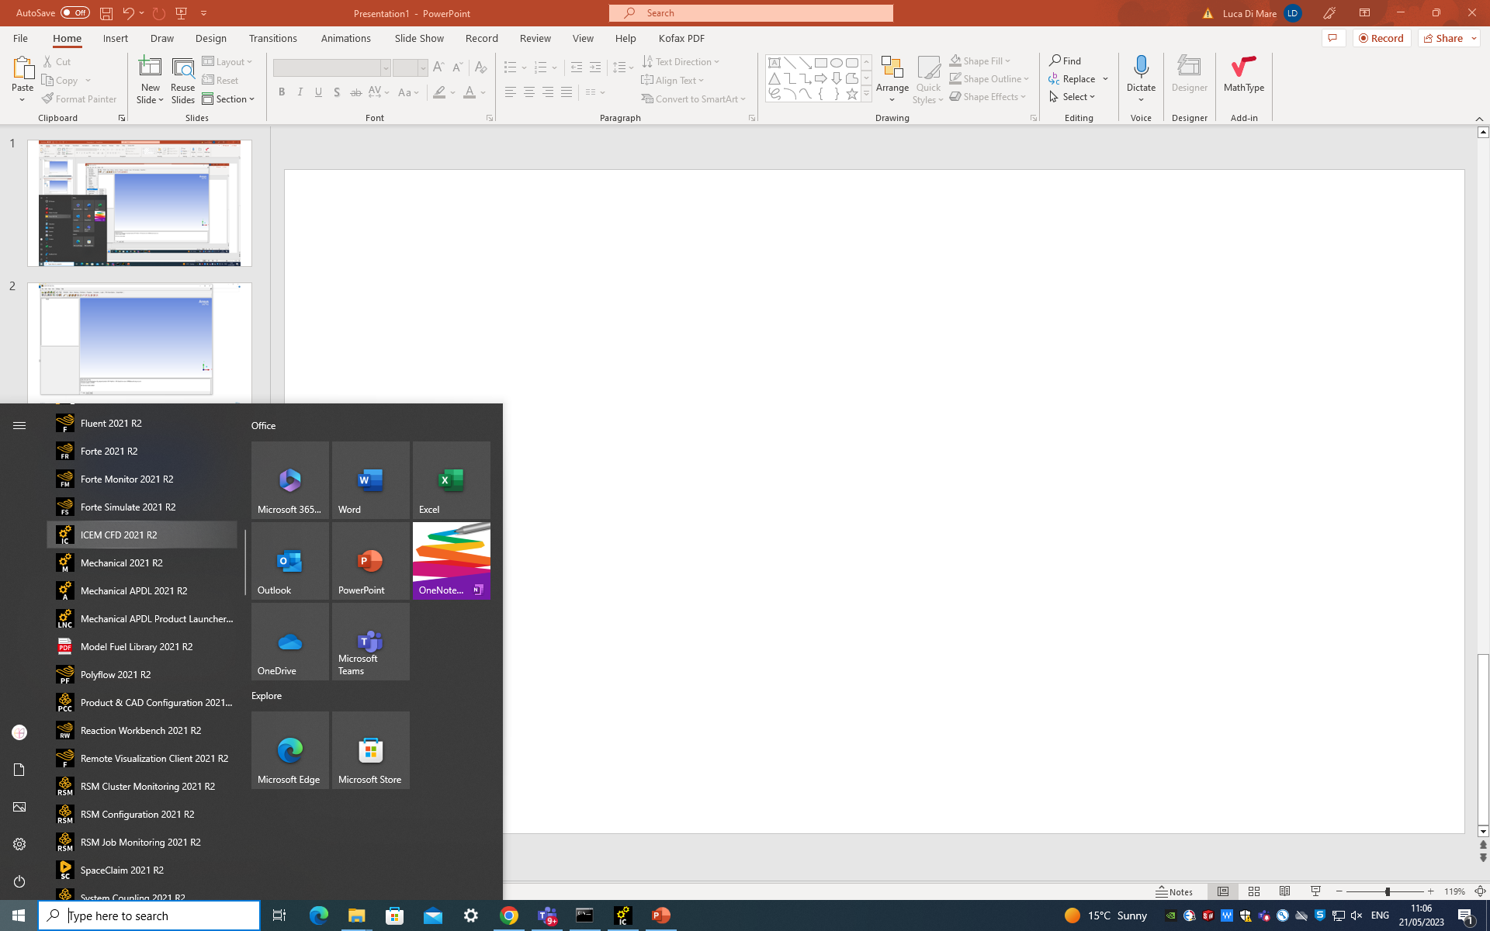
Select ICEM CFD

Slide 3
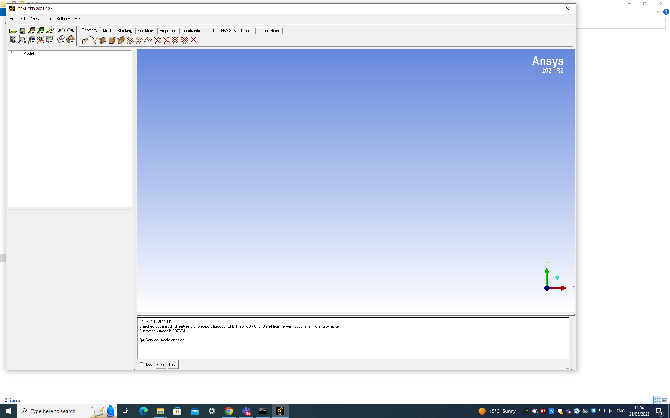
ICEM start window looks like this

Slide 4
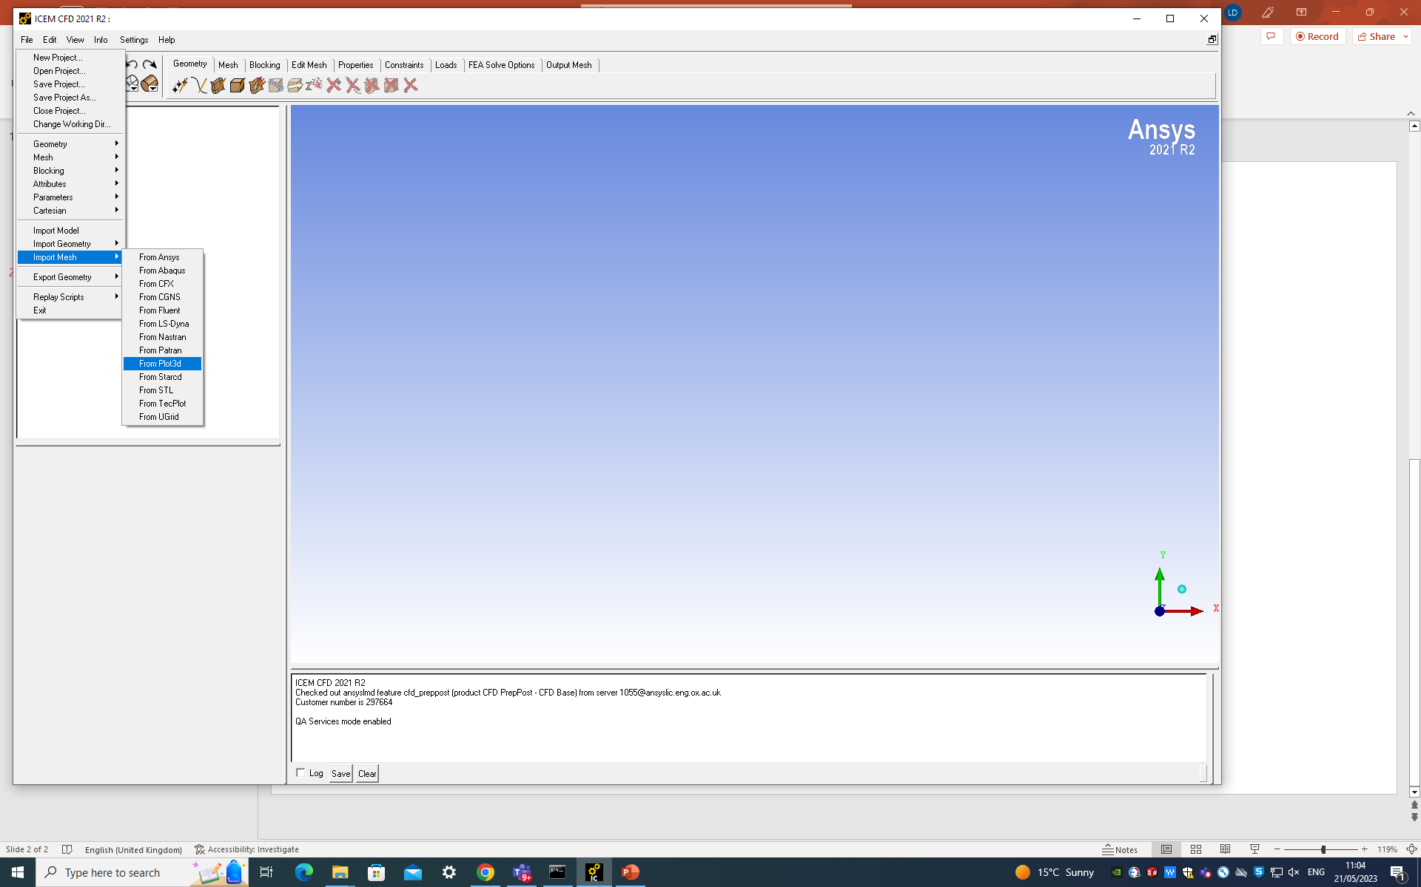
Select: File$→$Import mesh $→$From Plot3D

Slide 5
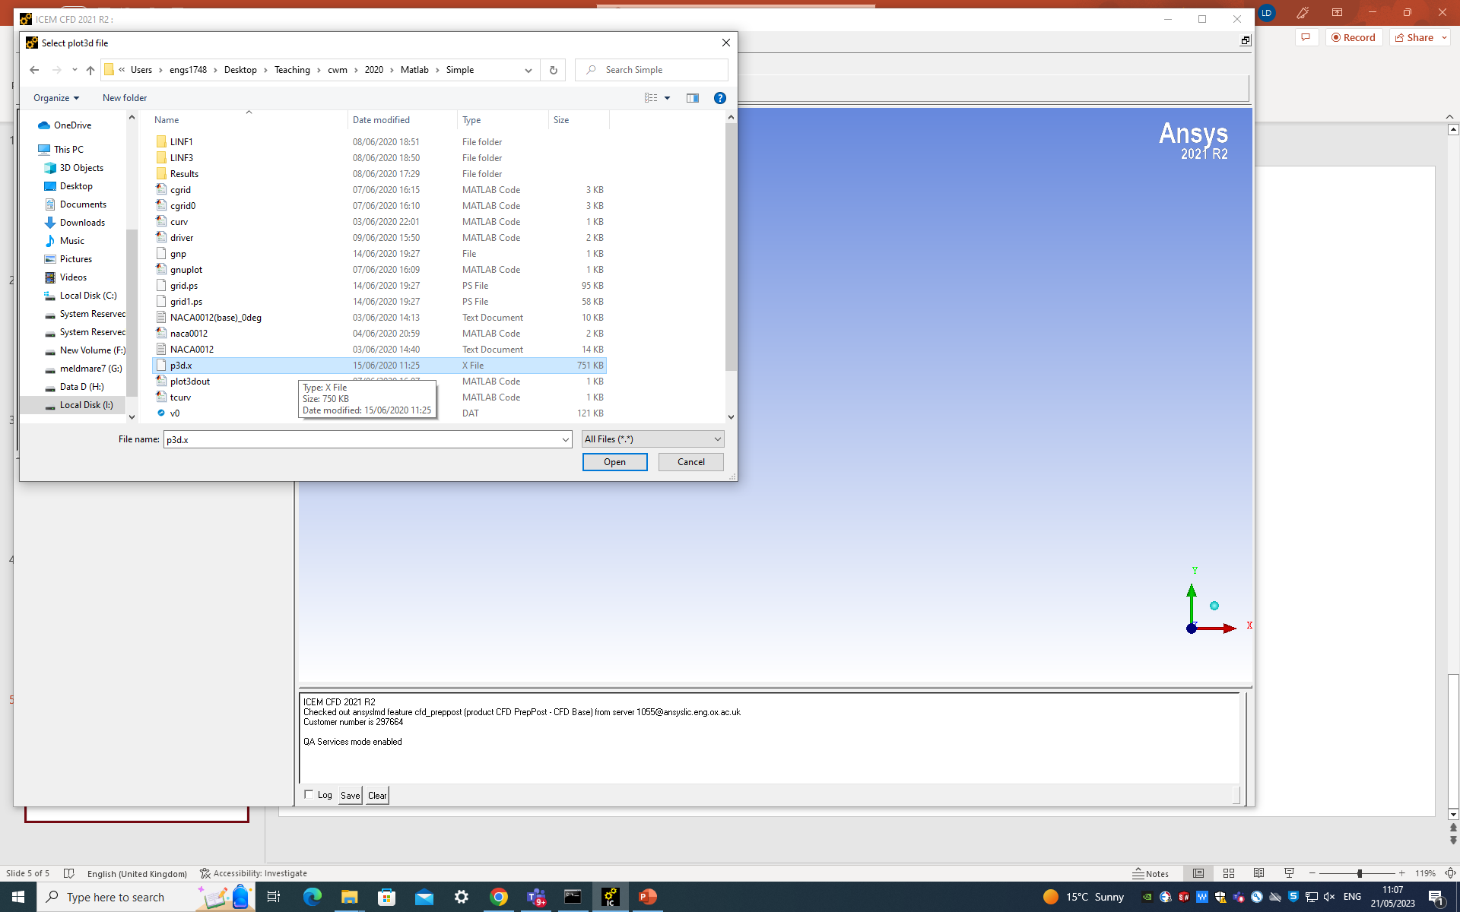
Go to the folder where your Matlab files are and select p3d.x

Slide 6
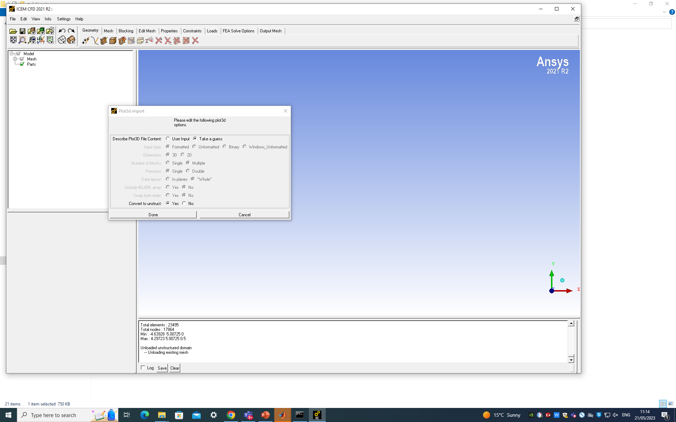
Click “Done” on this dialog

Slide 7
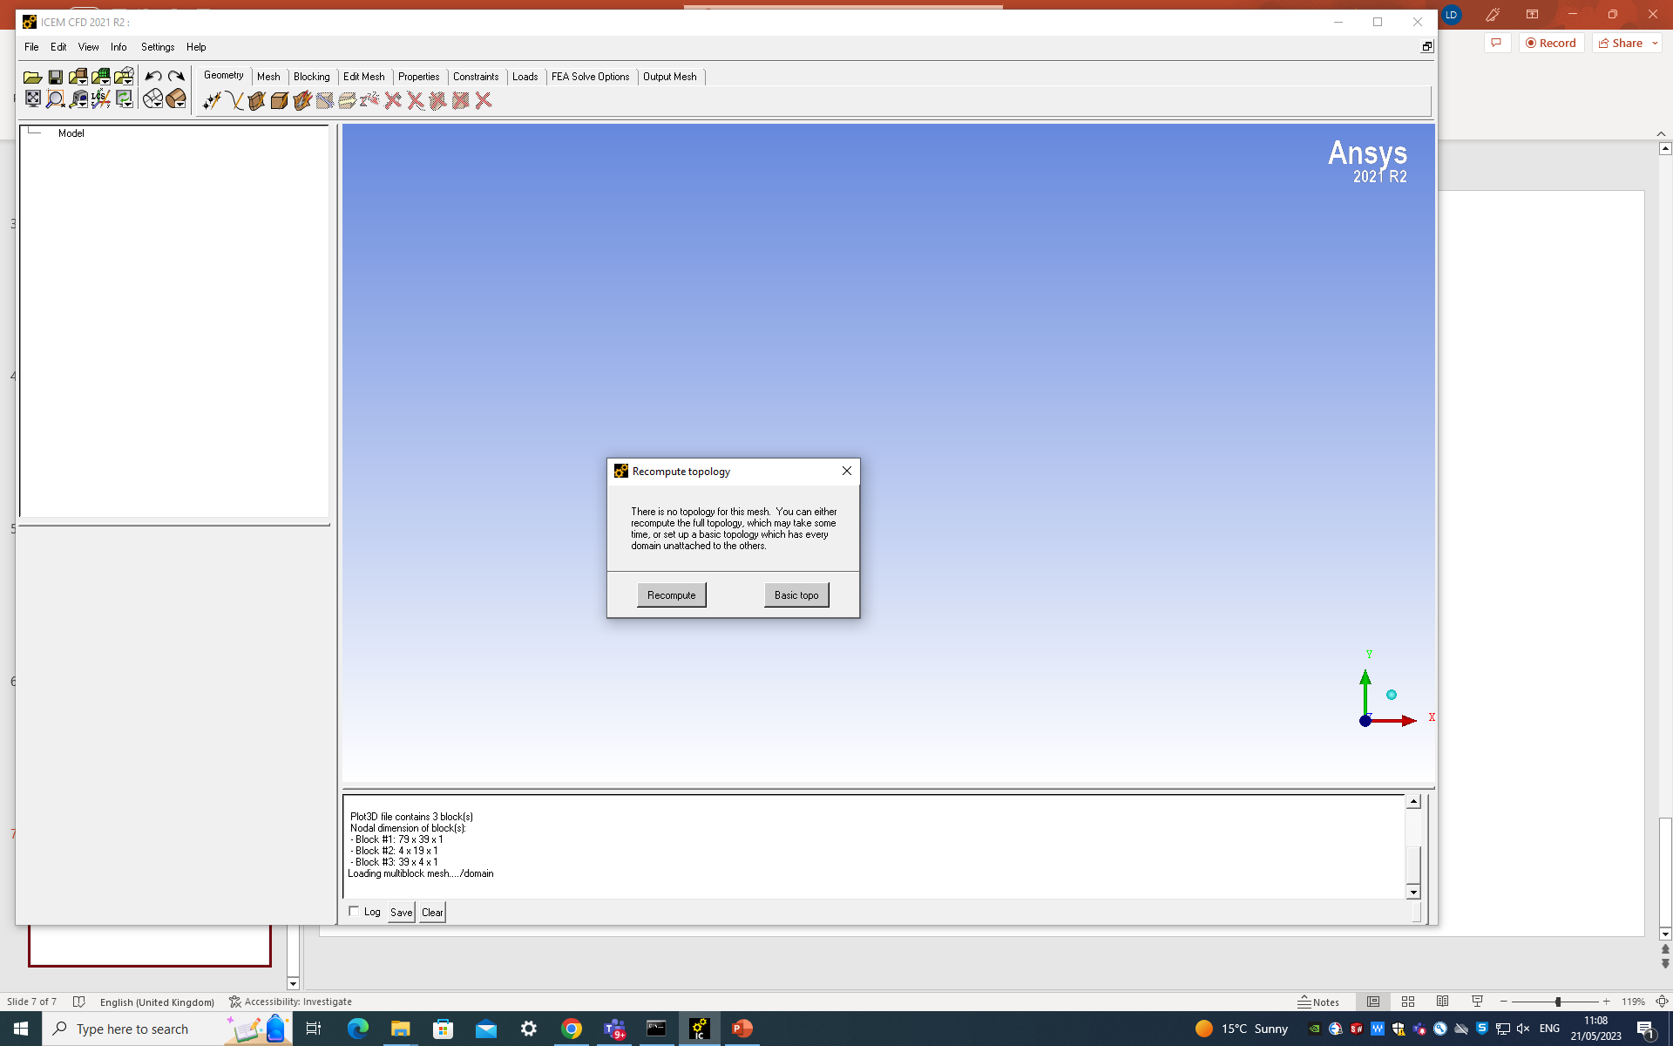
Click on “Recompute”: this will work out essential information for our CFD solution (namely which cell is neighbor with which)

Slide 8
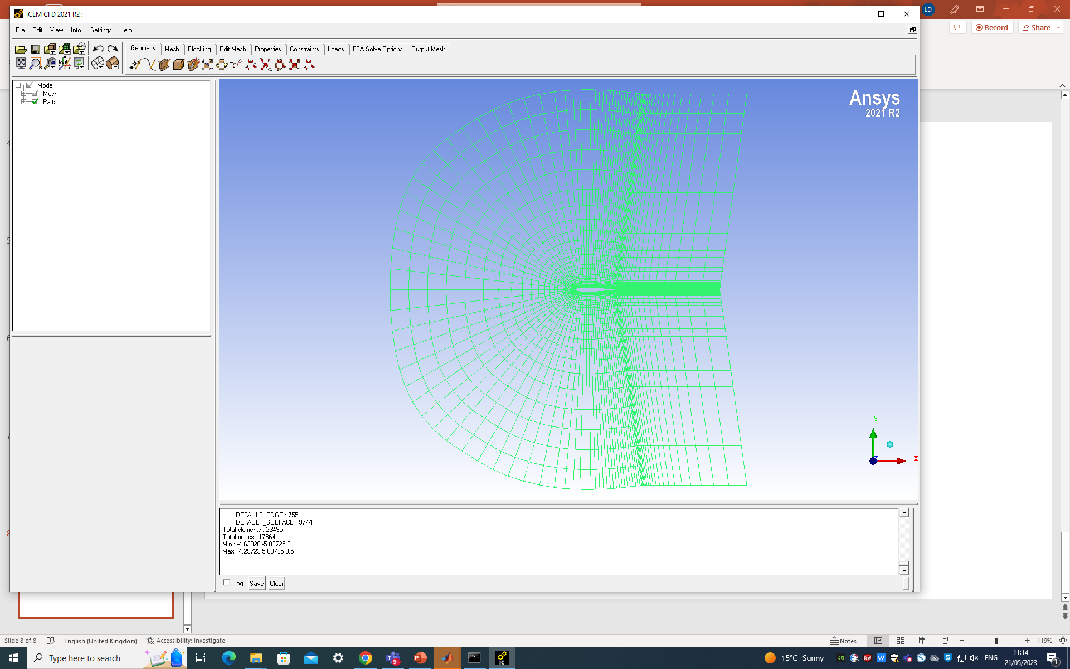
An outline of the computational domain should be now visible

Slide 9

Select the “Output mesh” tab and then for “Output Solver” select “CGNS”

Slide 10
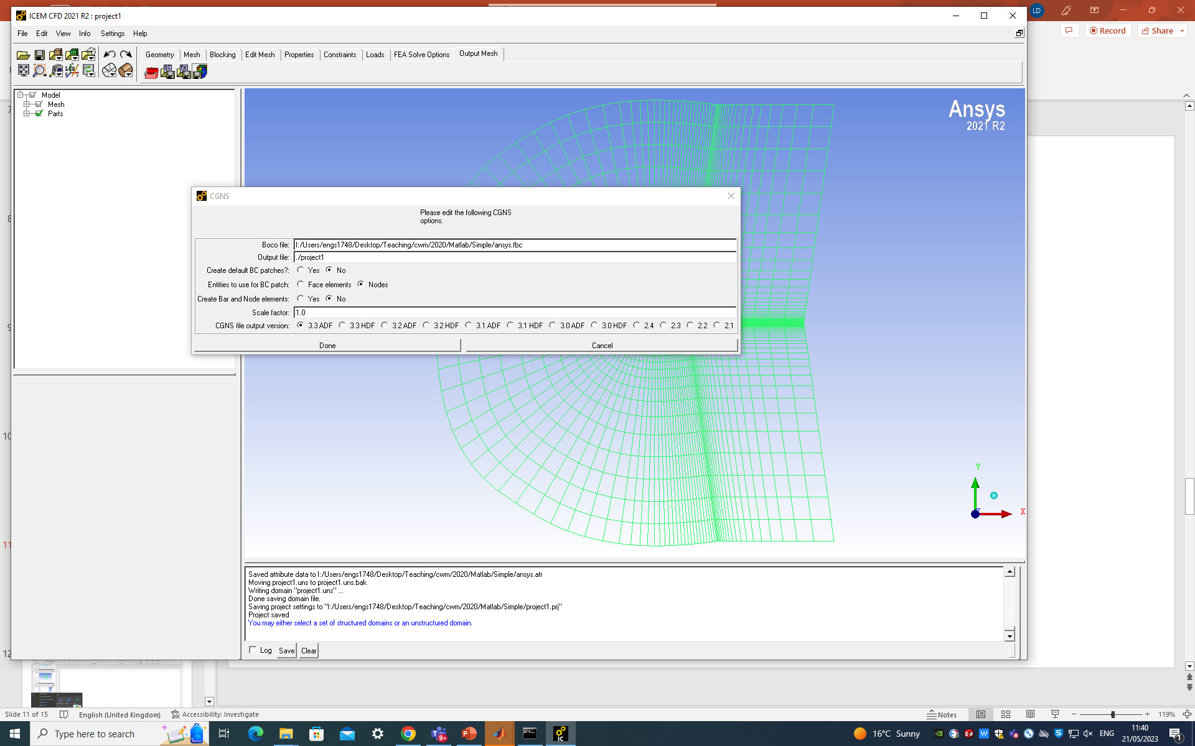
Make sure you select the directory where you want to run your Fluent case and click on “Done”

Slide 11
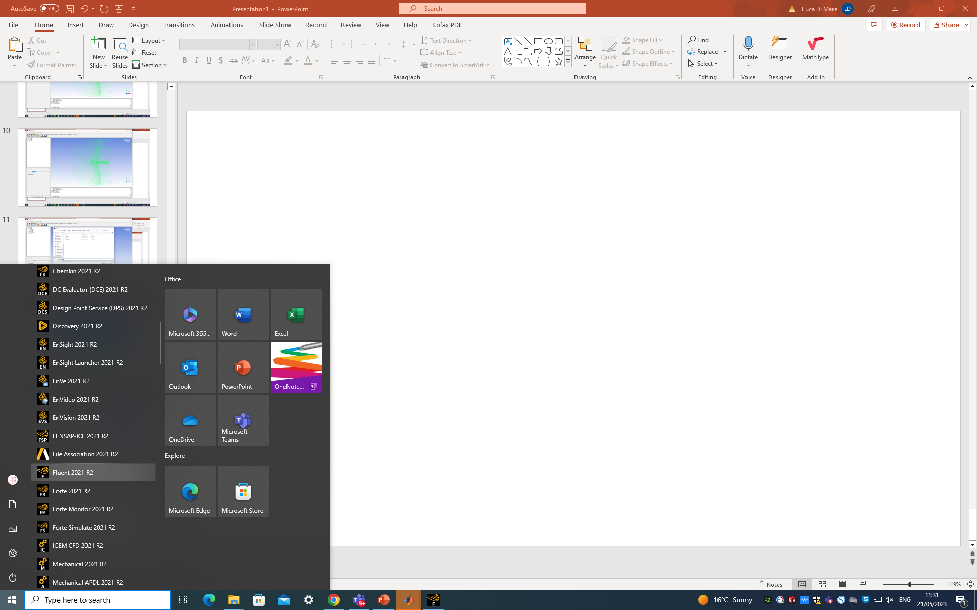
Now back to the Windows start menu and select “Fluent” from the Ansys submenu

Slide 12
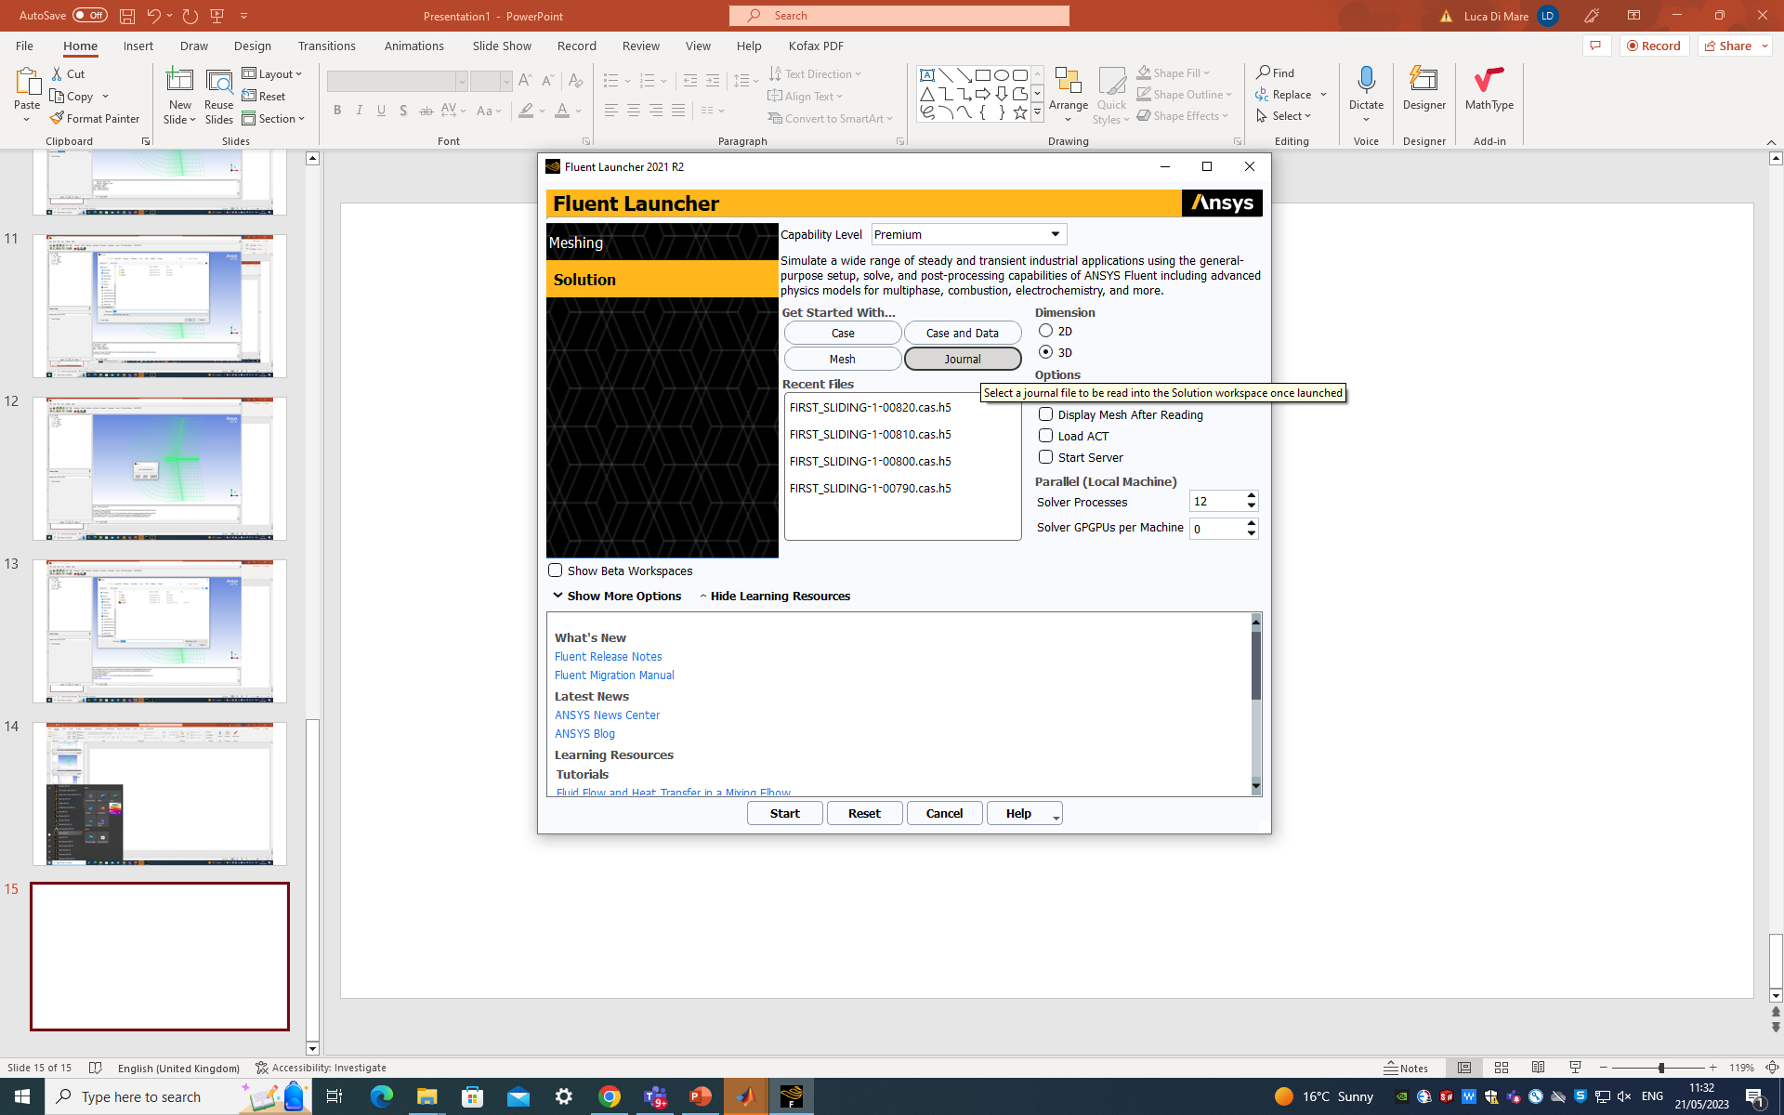
Select “Journal”

Slide 13
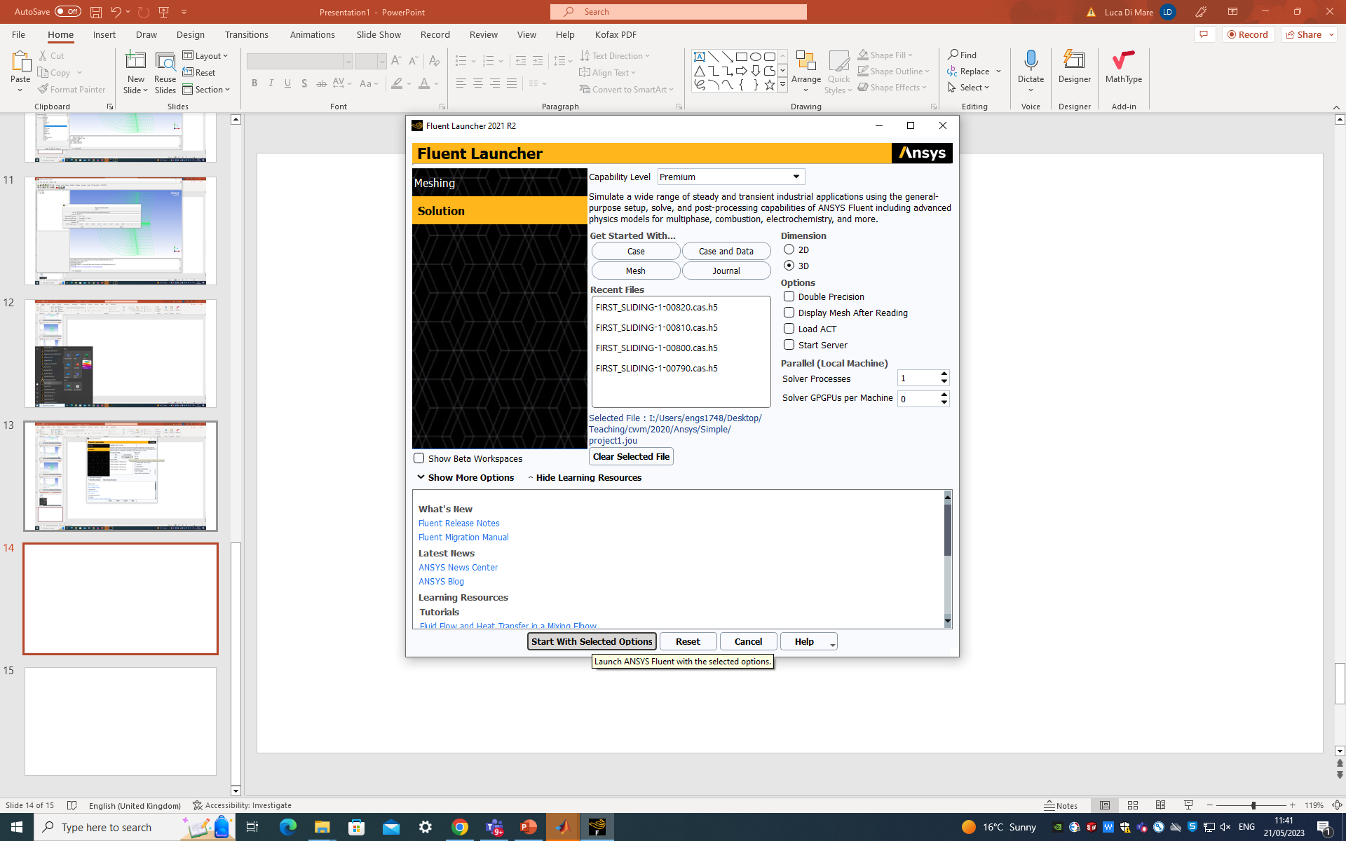
Select the Journal file from Canvas (make sure all paths point to a folder in your local disc)
Set “Solver processes” to “1”

Slide 14
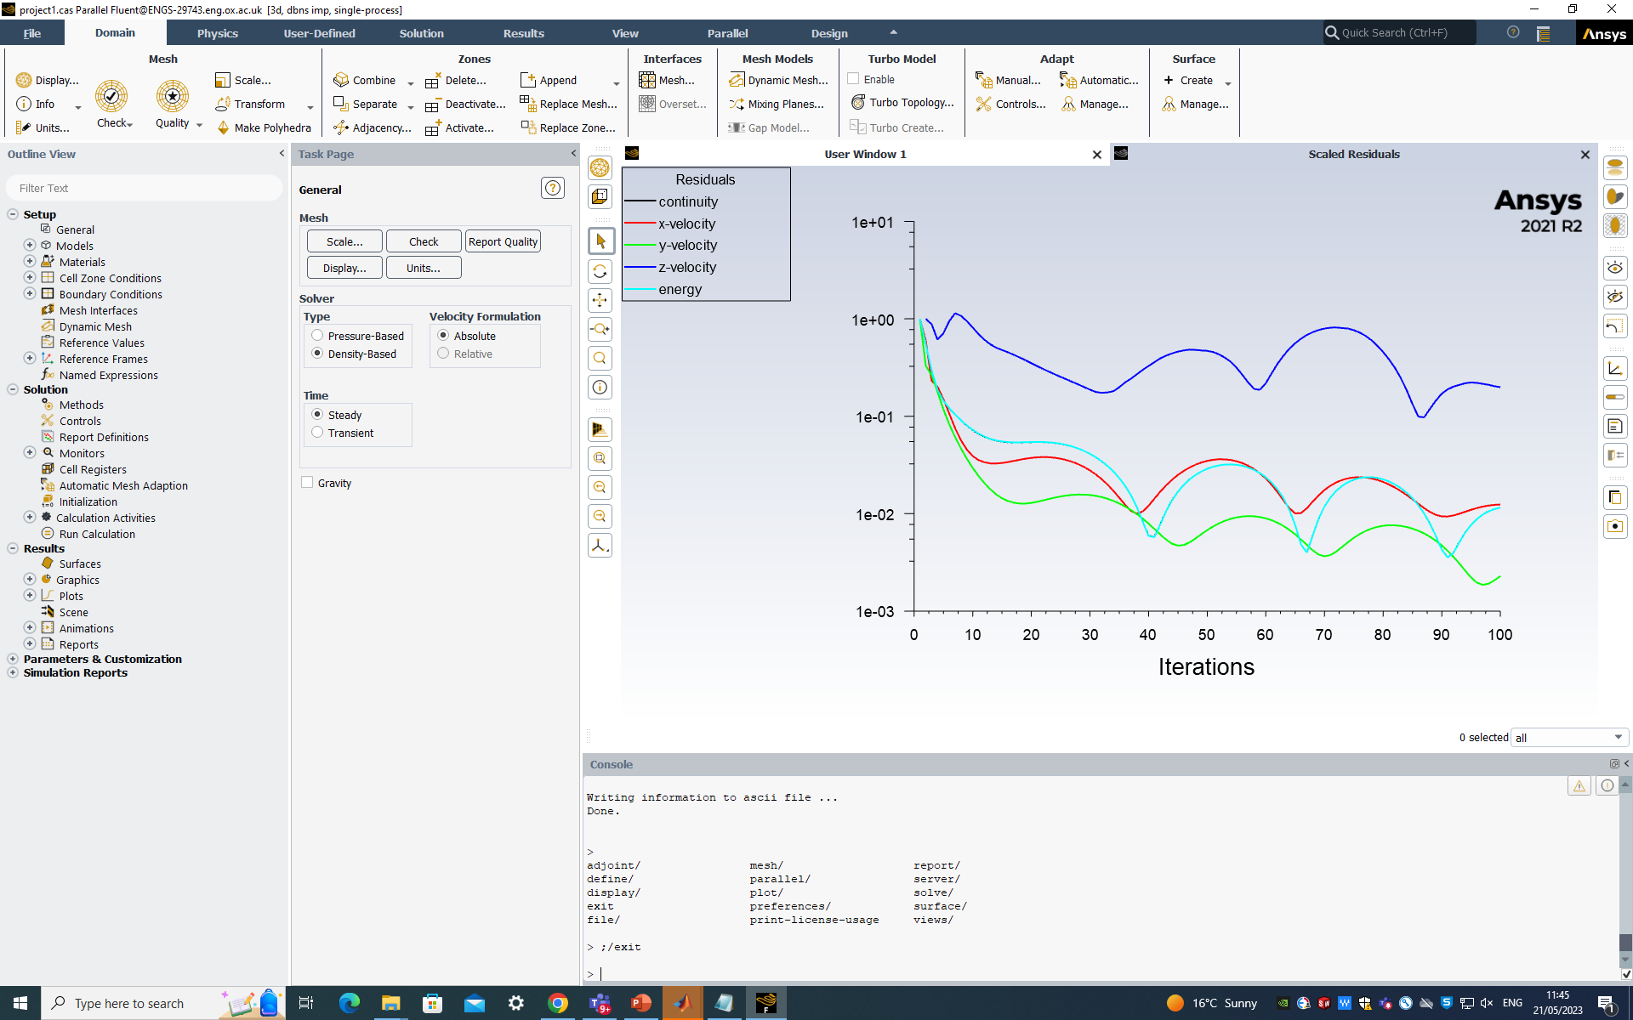
The program will start a series of operations. At the end it will show you a convergence history.
Make sure you discuss with your demonstrator what the commands in the journal file mean

